Slide 1

Olist E-Commerce Analysis
Transforming 100,000+ Brazilian marketplace orders into data-driven strategy — powered by Excel, SQL, Tableau, and Power BI.
TEAM PROJECT
7 ROLES · 4 TOOLS · 1 GOAL
Hari
Nidhi
Rohith
Pavani
Arpita
Padmavathi
Prathamesh

Slide 2
Business Requirements
📈 Sales Performance Analyze monthly sales and revenue trends.
🛍️ Product Performance Identify top-performing product categories.
🚚 Delivery Performance Measure on-time and late deliveries.
👥 Customer Behavior Understand customer purchasing patterns.
📊 Business Intelligence Enable data-driven decision-making through interactive dashboards.

Slide 3
The Team Challenge: Scaling Data-Driven Decisions
Seven specialists, one unified objective — turn raw e-commerce data into decisions that move the needle for marketing and operations.
Project Lead
Data Analysis Using SQL
Data Cleaning & Preparation
Business Intelligence Dashboard
Power BI Architect
Insights Strategist
Final Dashboard

Slide 4
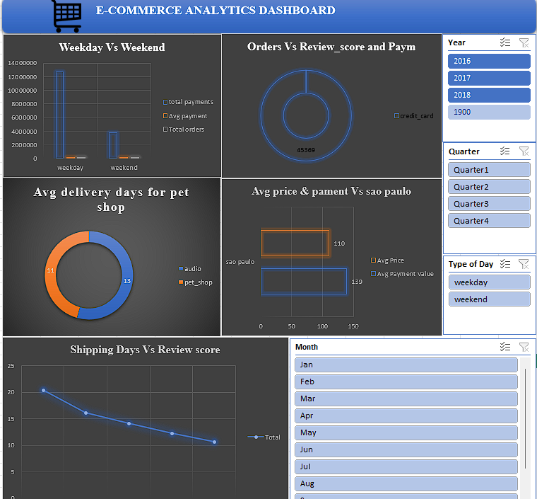
STAGE 1
Data Preparation with
Excel
Role: Data Cleaning &
Preparation through exel
The foundation of every reliable analysis. Clean, standardised data ensures every downstream insight is trustworthy.
Power Query
Pivot Tables
Exploratory Analysis
Standardise formats, remove duplicates, and handle nulls across all source files
Visualise revenue concentration and category-level performance at a glance
Identify outliers, data gaps, and initial trends before deeper modelling

Slide 5

STAGE 2
Data Validation & Logic with SQL
Role: Data Analysis Using SQL
SQL Analysis
Used SQL to clean and analyze the Olist e-commerce datasetPerformed JOINs to combine multiple tables.Used GROUP BY and aggregate functions (SUM, COUNT, AVG) to calculate KPIs.Applied WHERE conditions and date functions to filter and analyze data.
Key Acheivements
Extracted meaningful business insights from the dataset.Improved data accuracy through validation and query testing

Slide 6
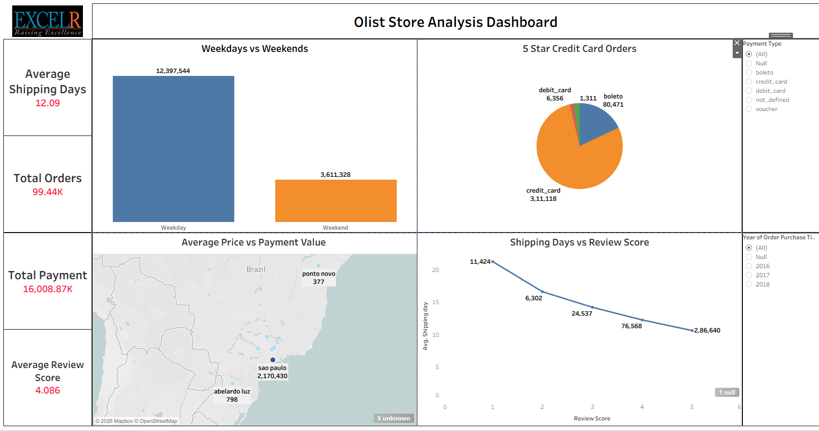
STAGE 3
Visual Intelligence with Tableau
Role: Interactive Data
Visualization
Translate complex datasets into intuitive, stakeholder-ready dashboards that drive decisions at a glance.
1
2
3
Geographic Heat Maps
Dual-Axis Charts
Executive Dashboards
Track regional sales concentration and identify underperforming states
Reveal the correlation between seasonality peaks and revenue trends
High-level views designed for non-technical stakeholders and leadership

Slide 7
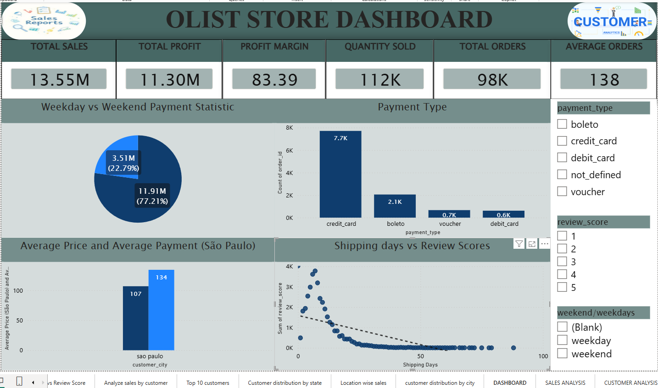
STAGE 4
Interactive Reporting with Power BI
DAX Measures
Calculate AOV, late-delivery rates, and category
growth with precision
Multi-Page Model
A comprehensive business model with drill-through
capabilities for Sales and Marketing
Real-Time KPIs
Live monitoring of operational metrics to support
rapid decision-making
Deep-Dive Filters
Interactive slicers enabling granular analysis by
region, category, and timeframe

Slide 8

Conclusion
This project demonstrates an end-to-end data analytics workflow using SQL, Excel, Tableau, and Power BI. The analysis transformed raw e-commerce data into actionable insights that can help improve sales performance, customer satisfaction, and operational decision-making.

Slide 9
Thank you !!

